Slide 1

Characterizing Crosslinked Polymer Networks by Rajawasam, Chamoni WH, et al.
presented by Lena Aßmann
24.07.2026

Slide 2
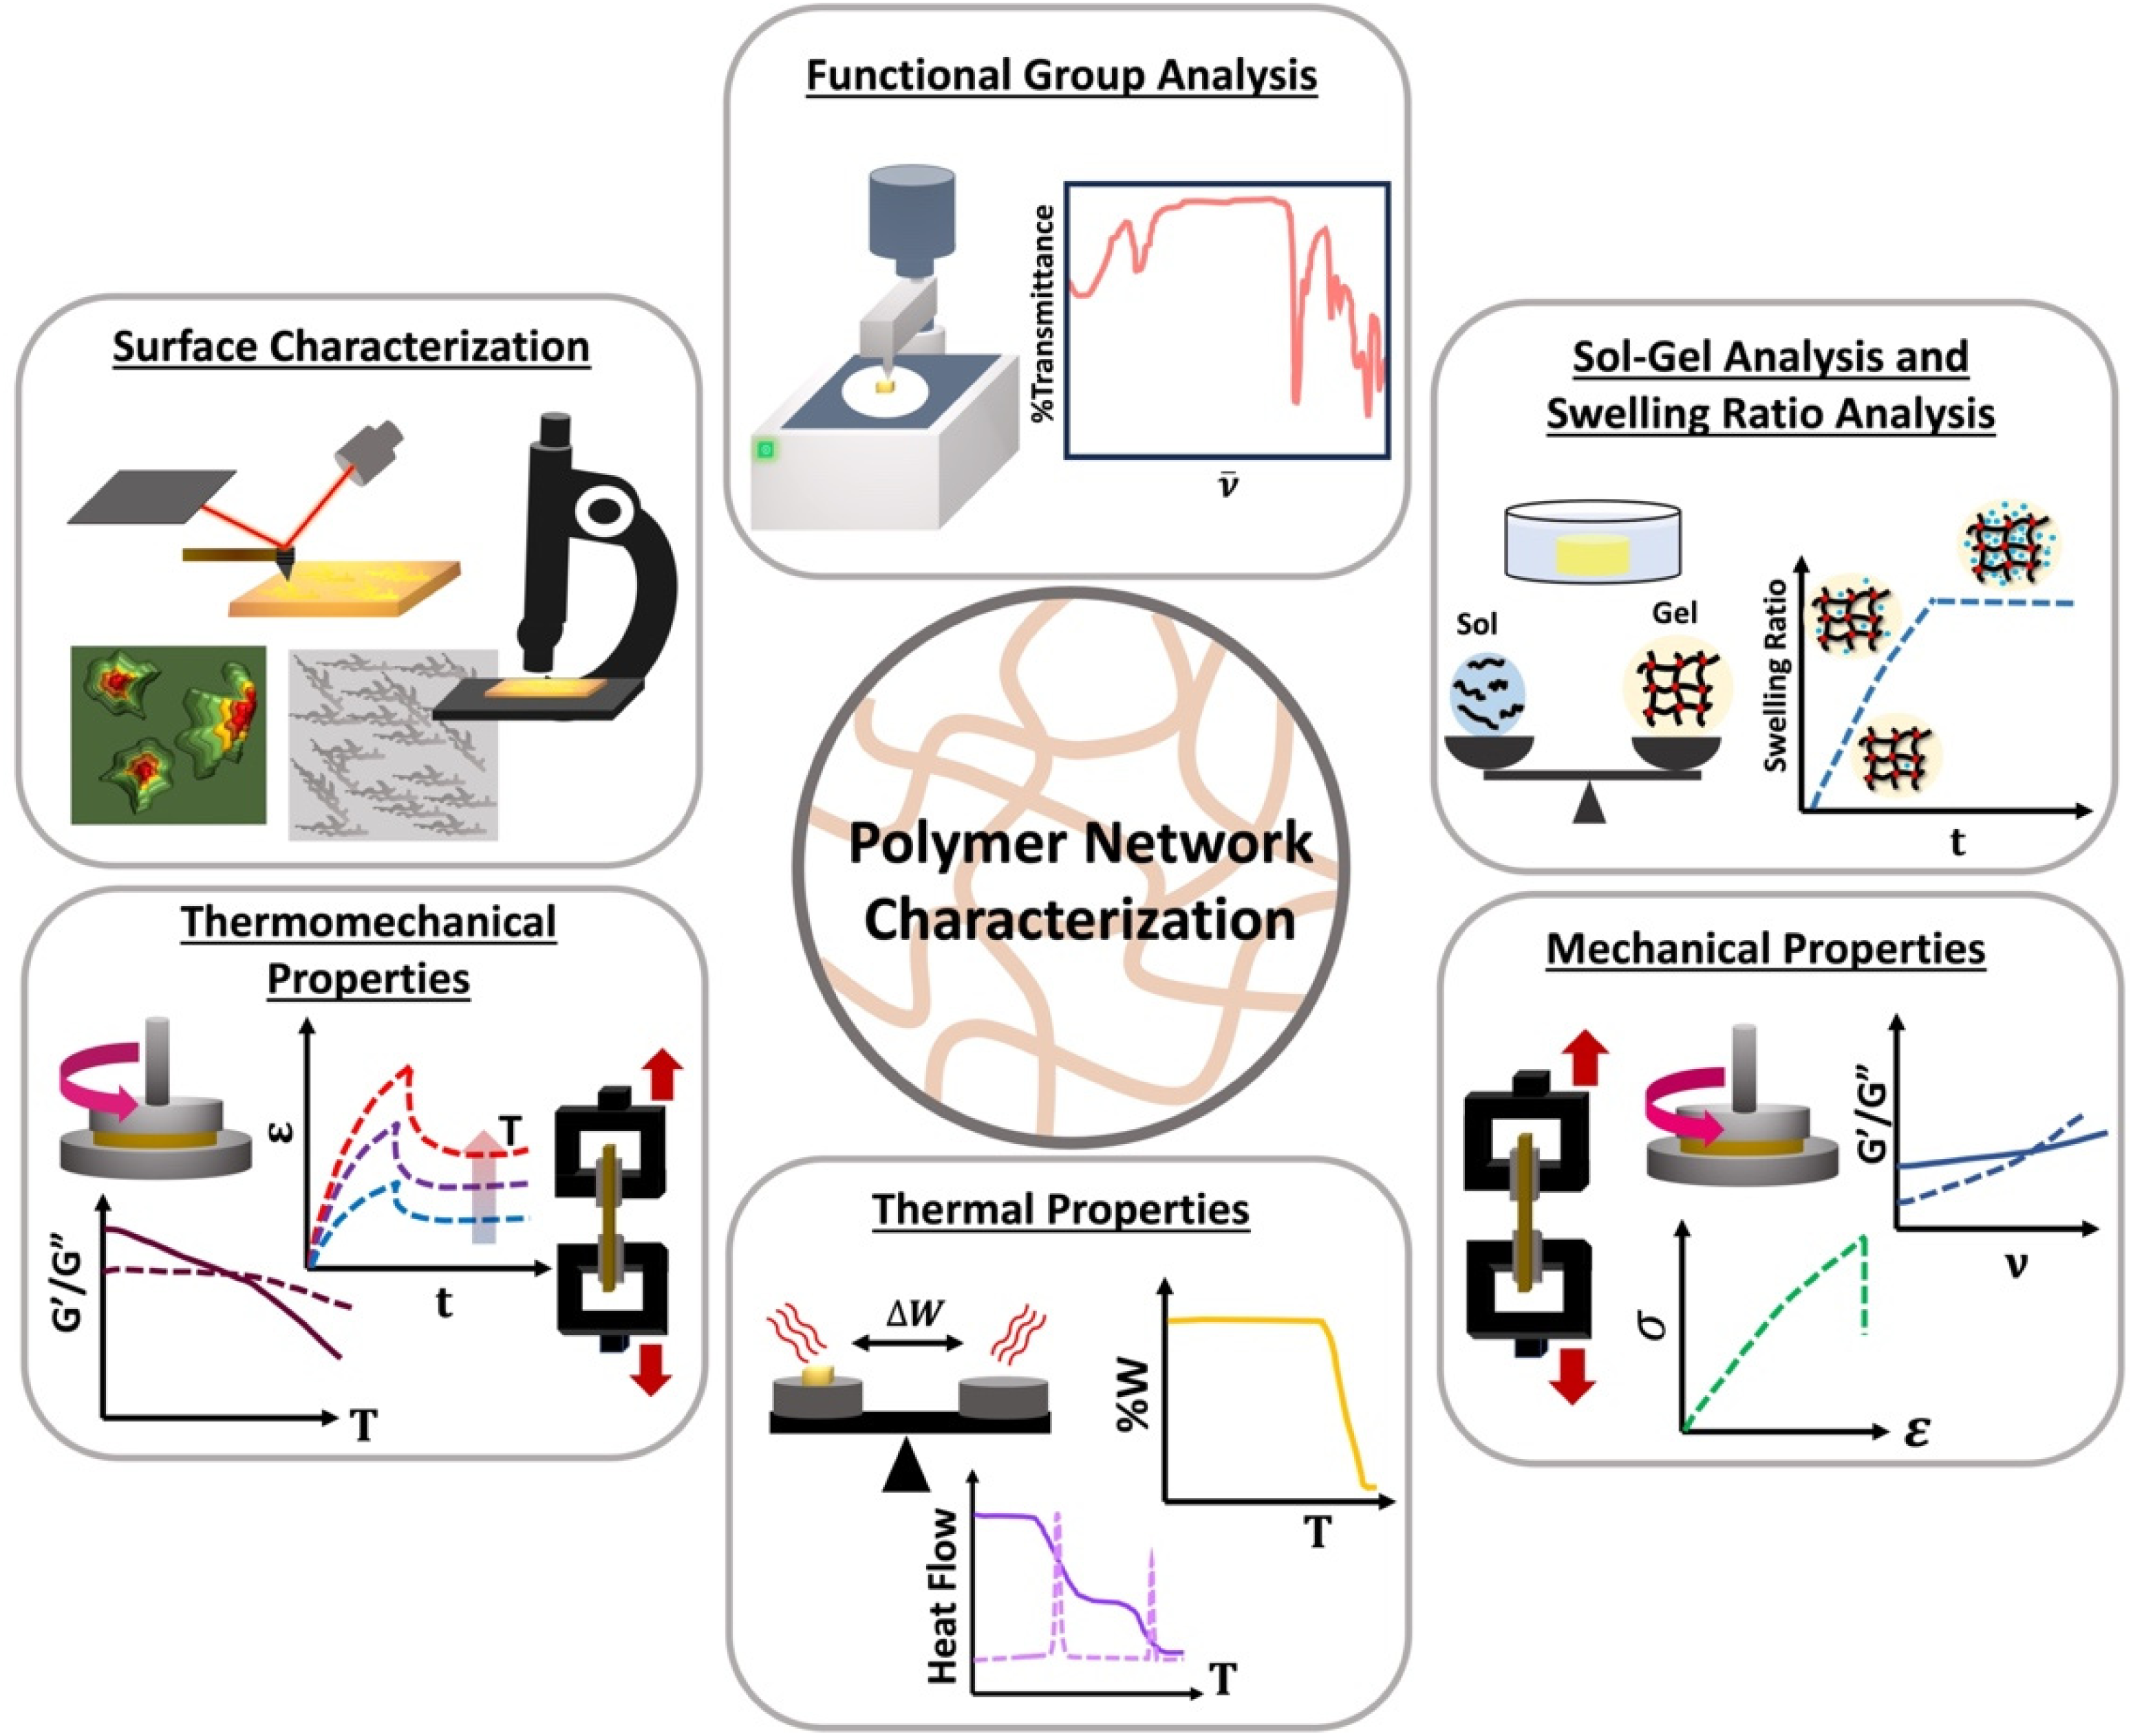
Different areas of characterization

Slide 3
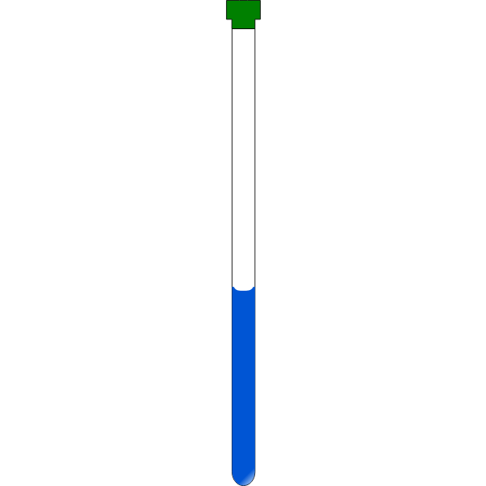
Typical analysis of (non-crosslinked) polymers
not applicable for crosslinked systems
liquid-state NMR
size exclusion chromatography

Slide 4
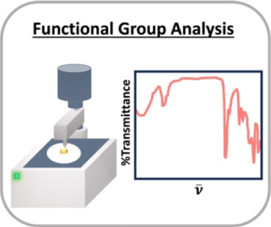
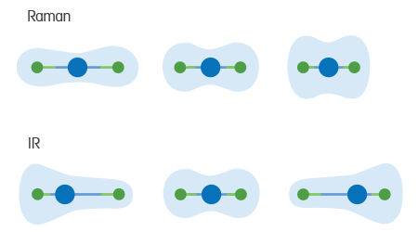
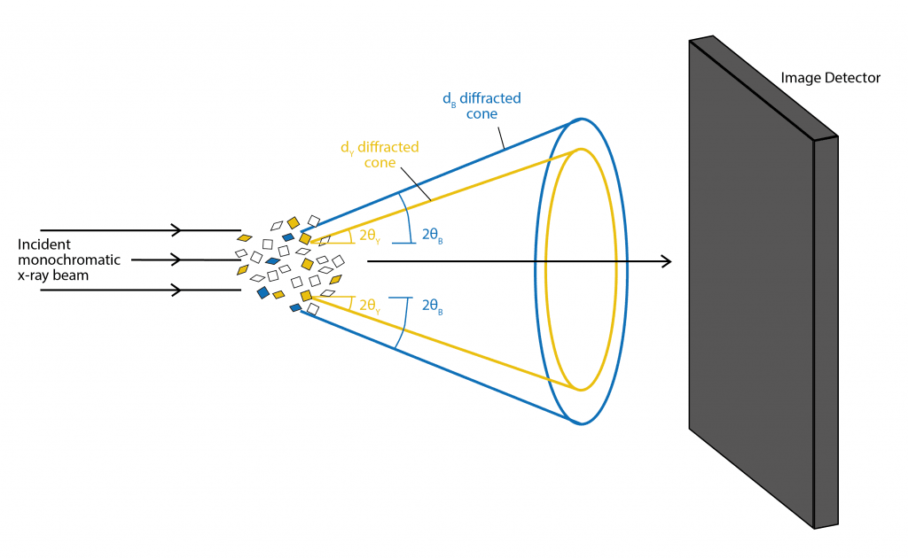
PXRD
Complementary information
Real time measurements possible

Slide 5
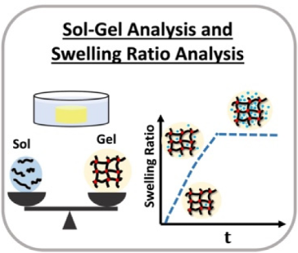
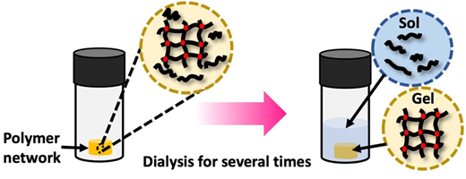
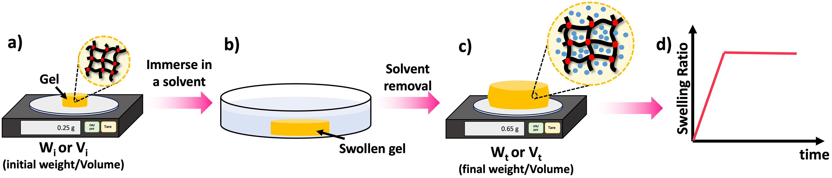
Sol: soluble fraction
monomer & crosslinkers
oligomers
non-crosslinked polymer
Soxhlet extraction

Slide 6
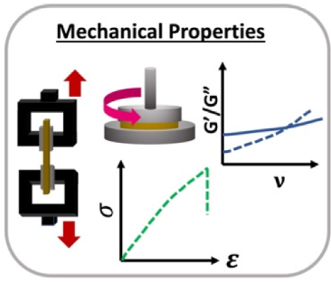
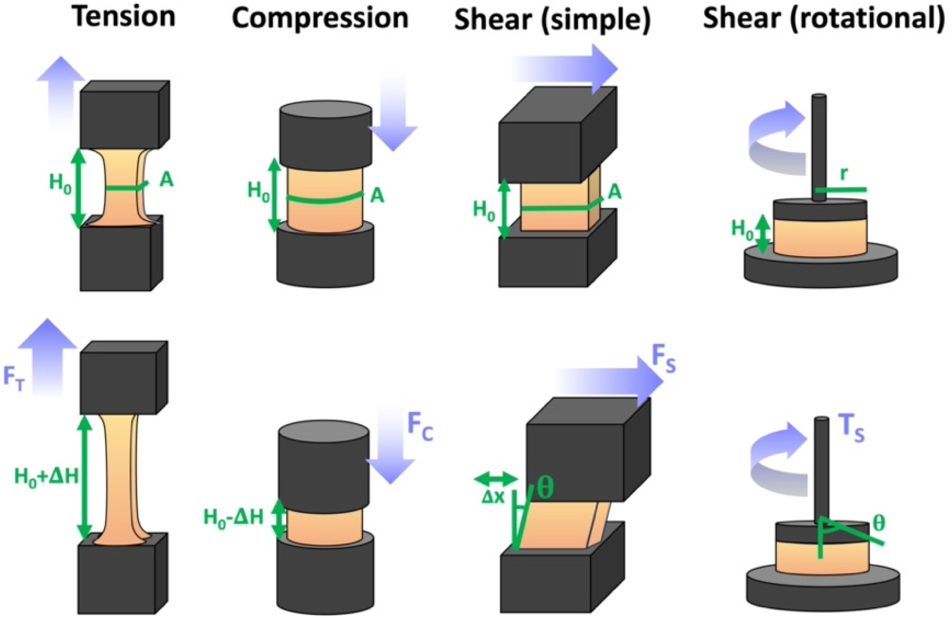
Calculation of stress (σ) and strain (ε)
Moduli approximately ratio of σ/ε for linear stress-strain-curve
Compression and tensile testing provide Young‘s modulus (E,Y)
Shear testing yields shear modulus (G)

Slide 7

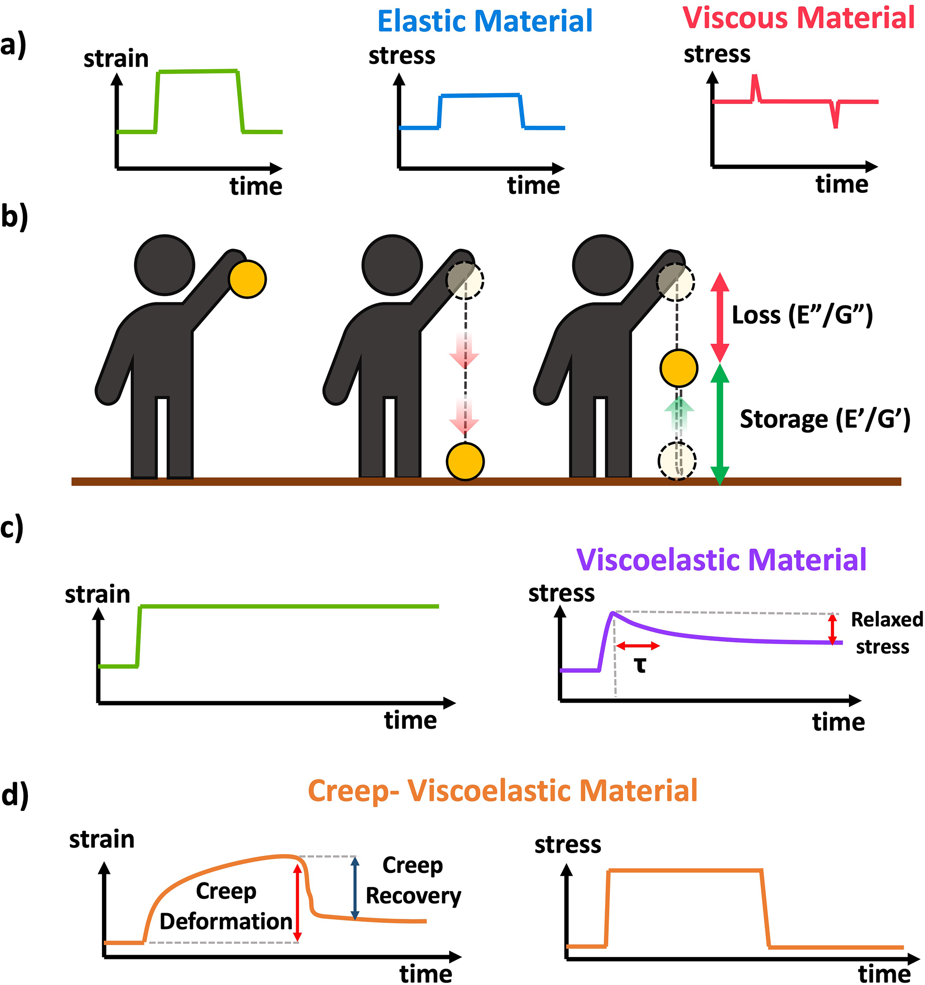
Ideal elastic material | Ideal viscous material
Perfectly stores energy & maintains stress | Dissipates energy as strain is applied/removed
Reality
Most polymer materials are viscoelastic

Slide 8
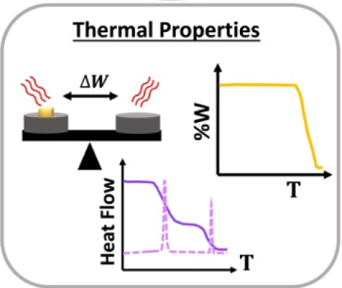
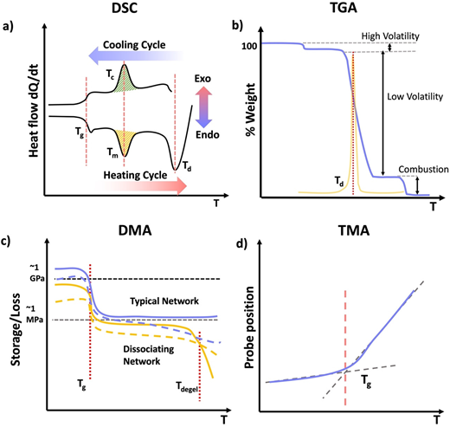

Slide 9
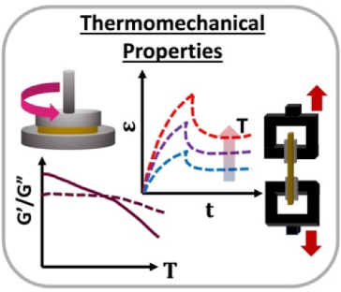
dynamic mechanical
analysis
thermomechanical
analysis

Slide 10

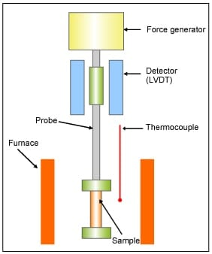
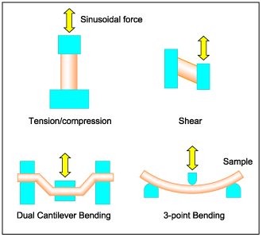
DMA
Information on:
Storage modulus (E´,G´)
Loss modulus (E´´,G´´)
Loss tangent (tan δ = E´´/E´ = G´´/G´)
as a function of temperature/frequency

Slide 11
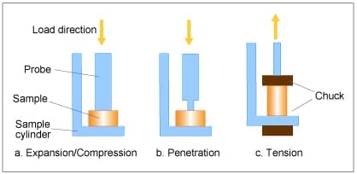
TMA
Measurement of the deformation/changes in dimension as a function of temperature, time and force
Thermal expansion
Size/position of probe changes to maintain zero force
Coefficient of thermal expansion
Changes above T_{g}

Slide 12
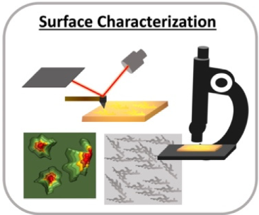
SMKS
Morphology | Surface
SEM | XPS | X-ray photoelectron spectroscopy
TEM | ToF-SIMS | time-of-flight secondary ion mass spectroscopy
AFM | LEIS | low energy ion-scattering spectroscopy
 | AES | Auger electron spectroscopy

Slide 13

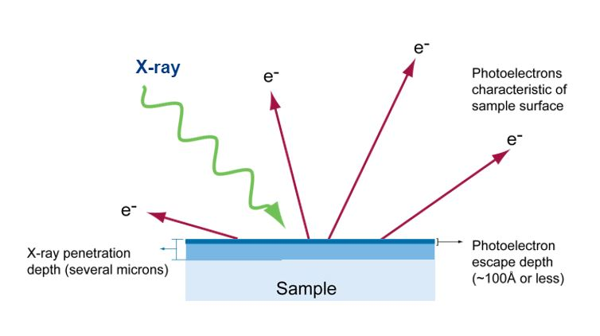
XPS
Surface elemental composition
Chemical and electronic states of atoms within material
Result: number of electrons against binding energy
Limitations:
Ultrahigh vacuum needed
Surface charge can compromise data accuracy
Sensitivity: 0.1-1 at% (except H & He)

Slide 14
Sources
https://freesvg.org/filled-nmr-tube (accessed on 22.07.2026)
https://commons.wikimedia.org/wiki/File:GPC_Trennung_Cartoon.gif (accessed on 22.07.2026)
https://www.mt.com/ch/de/home/applications/L1_AutoChem_Applications/Raman-Spectroscopy/raman-vs-ir-spectroscopy.html (accessed on 22.07.2026)
https://www.teledynevisionsolutions.com/de-de/learn/learning-center/scientific-imaging/introduction-to-x-ray-diffraction/ (accessed on 22.07.2026)
https://en.wikipedia.org/wiki/Soxhlet_extractor#/media/File:Soxhlet_mechanism.gif (accessed on 22.07.2026)
https://www.hitachi-hightech.com/global/en/knowledge/analytical-systems/thermal-analysis/basics/dma.html (accessed on 22.07.2026)
https://www.hitachi-hightech.com/global/en/knowledge/analytical-systems/thermal-analysis/basics/tma.html (accessed on 22.07.2026)
https://www.eag.com/techniques/spectroscopy/x-ray-photoelectron-spectroscopy-xps-esca/ (accessed on 22.07.2026)

Slide 15
Any questions?

